Slide 1
Describing Logic Circuits-II

Slide 2
3-9 NOR Gates and NAND Gates
Combine basic AND, OR, and NOT operations.
Simplifying the writing of Boolean expressions
Output of NAND and NOR gates may be found by determining the output of an AND or OR gate, and inverting it.
The truth tables for NOR and NAND gates show the complement of truth tables for OR and AND gates.

Slide 3
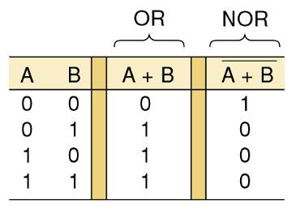
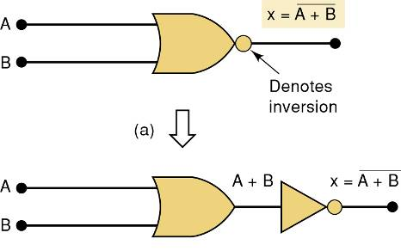
3-9 NOR Gates
An inversion “bubble” is placed at the output of the OR gate, making the Boolean output expression x = A + B
The NOR gate is an inverted OR gate.

Slide 4
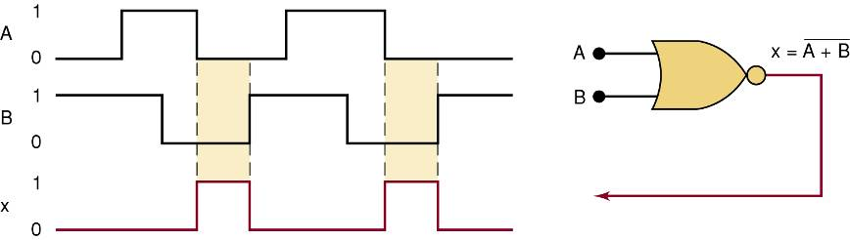
3-9 NOR Gates
Output waveform of a NOR gate for the input waveforms shown here.

Slide 5
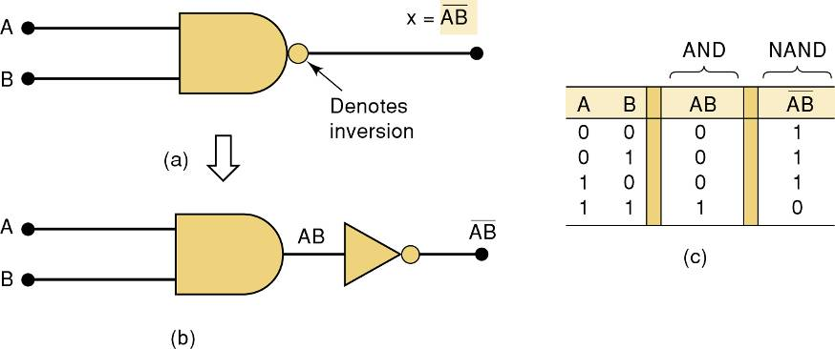
3-9 NAND Gates
An inversion “bubble” is placed at the output of the AND gate, making the Boolean output expression x = AB
The NAND gate is an inverted AND gate.

Slide 6
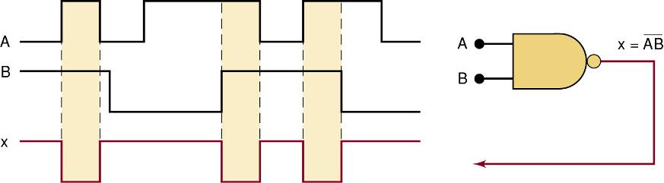
3-9 NAND Gates
Output waveform of a NAND gate for the input waveforms shown here.

Slide 7
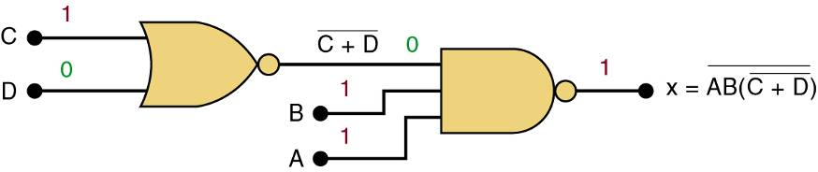
3-9 NOR Gates and NAND Gates
Logic circuit with the expression x = AB • (C + D) using only NOR and NAND gates.

Slide 8
3-10 Boolean Theorems
The theorems or laws that follow may represent an expression containing more than one variable.

Slide 9
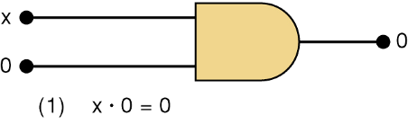
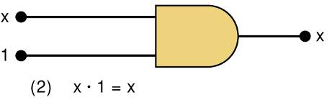
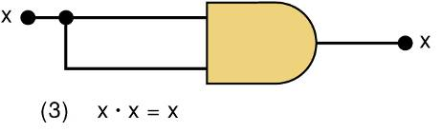
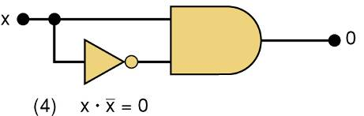
3-10 Boolean Theorems
Theorem (1) states that if any variable is ANDed with 0, the result must be 0.
Theorem (2) is also obvious by comparison with ordinary multiplication.
Prove Theorem (3) by trying each case. If x = 0, then 0 • 0 = 0
If x = 1, then 1 • 1 = 1
Thus, x • x = x
Theorem (4) can be proved in the same manner.

Slide 10
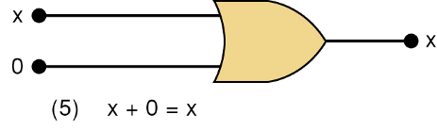
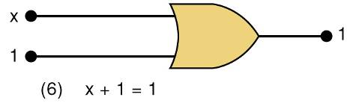
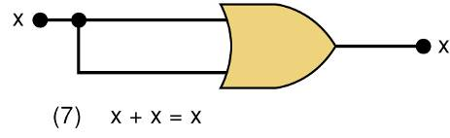
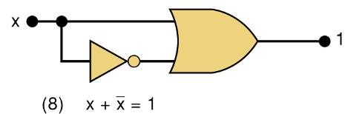
3-10 Boolean Theorems
Theorem (5) is straightforward, as 0 added to anything does not affect value, either in regular addition or in OR addition.
Theorem (6) states that if any variable is ORed with 1, the is always 1.
Check values: 0 + 1 = 1 and 1 + 1 = 1.
Theorem (7) can be proved by checking for both values of x: 0 + 0 = 0 and 1 + 1 = 1.
Theorem (8) can be proved similarly.

Slide 11
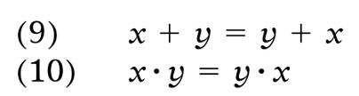


3-10 Boolean Theorems
Multivariable Theorems
Commutative laws
Associative laws
Distributive law

Slide 12
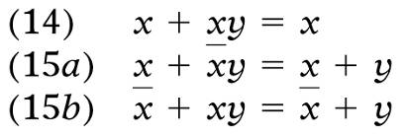
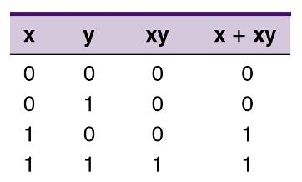

3-10 Boolean Theorems
Theorems (14) and (15) do not have counterparts in ordinary algebra. Each can be proved by trying all possible cases for x and y.
Analysis table & factoring for Theorem (14)

Slide 13
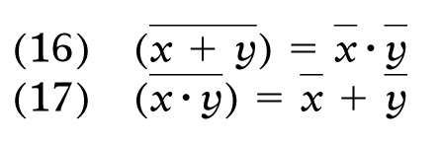
3-11 DeMorgan’s Theorems
DeMorgan’s theorems are extremely useful in simplifying expressions in which a product or sum of variables is inverted.
Theorem (16) says inverting the OR sum of two variables is the same as inverting each variable individually, then ANDing the inverted variables.
Theorem (17) says inverting the AND product of two variables is the same as inverting each variable individually and then ORing them.
Each of DeMorgan’s theorems can readily be proven by checking for all possible combinations of x and y.

Slide 14
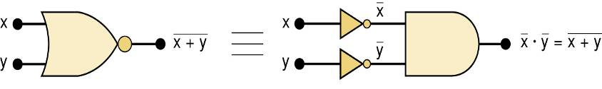
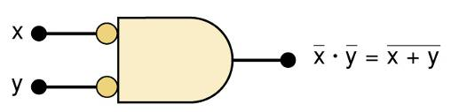
3-11 DeMorgan’s Theorems
Equivalent circuits implied by Theorem (16)
The alternative symbol for the NOR function.

Slide 15
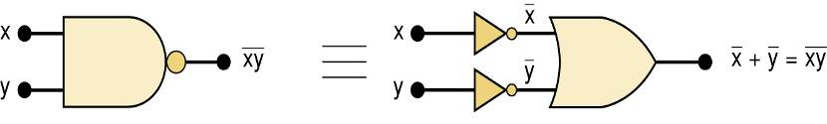
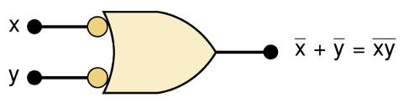
3-11 DeMorgan’s Theorems
Equivalent circuits implied by Theorem (17)
The alternative symbol for the NAND function.

Slide 16
3-12 Universality of NAND and NOR Gates
NAND or NOR gates can be used to create the three basic logic expressions.
OR, AND, and INVERT.
Provides flexibility—very useful in logic circuit design.

Slide 17
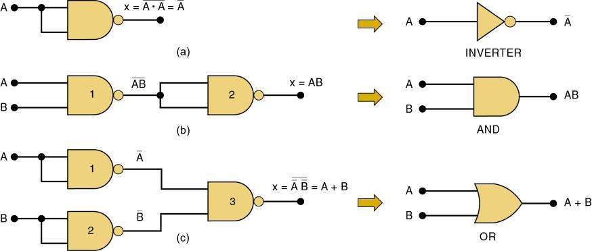
3-12 Universality of NAND and NOR Gates
How combinations of NANDs or NORs are used to create the three logic functions.
It is possible, however, to implement any logic expression using only NAND gates and no other type of gate, as shown.

Slide 18
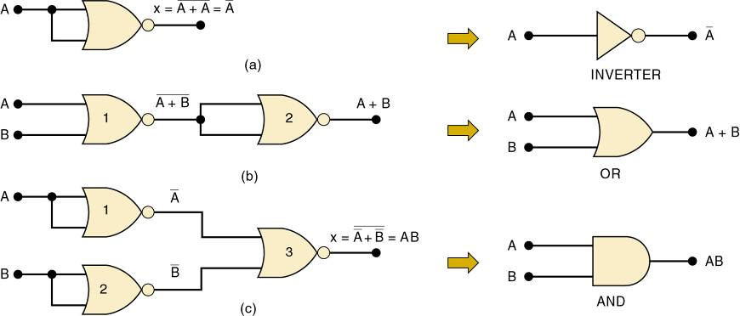
3-12 Universality of NAND and NOR Gates
How combinations of NANDs or NORs are used to create the three logic functions.
NOR gates can be arranged to implement any of the Boolean operations, as shown.

Slide 19
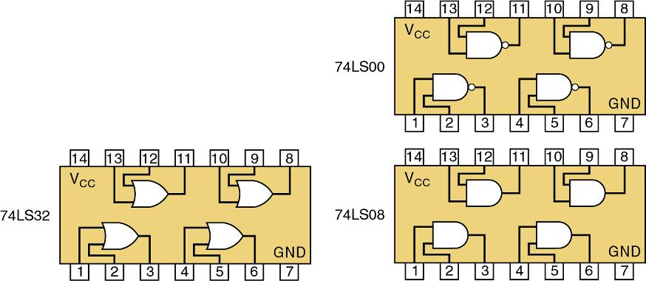
A logic circuit to generate a signal x, that will go HIGH whenever conditions A and B exist simultaneously, or whenever conditions C and D exist simultaneously.
The logic expression will be x = AB + CD.
Each of the TTL(transistor-transistor logic) ICs shown here will fulfill the function. Each IC is a quad, with four identical gates on one chip

Slide 20
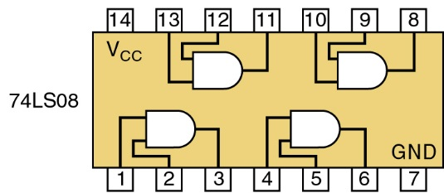
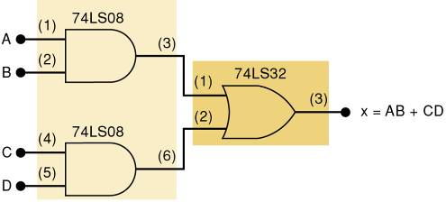
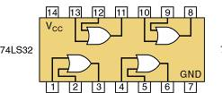
3-12 Universality of NAND and NOR Gates
Possible Implementations # 1

Slide 21
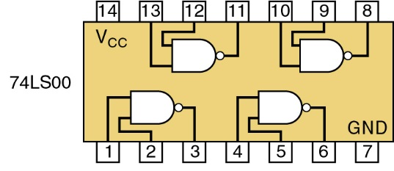
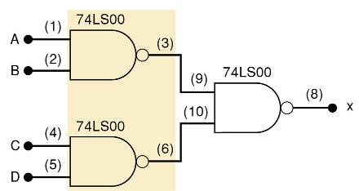
3-12 Universality of NAND and NOR Gates
Possible Implementations #2

Slide 22

3-13 Alternate Logic-Gate Representations
To convert a standard symbol to an alternate:
Invert each input and output in standard symbols.
Add an inversion bubble where there are none.
Remove bubbles where they exist.

Slide 23
3-13 Alternate Logic-Gate Representations
Active-HIGH – an input/output has no inversion bubble.
Active-LOW – an input or output has an inversion bubble.

Slide 24
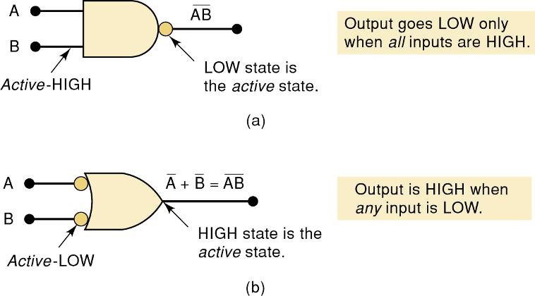
3-13 Alternate Logic-Gate Representations
Interpretation of the two NAND gate symbols.

Slide 25
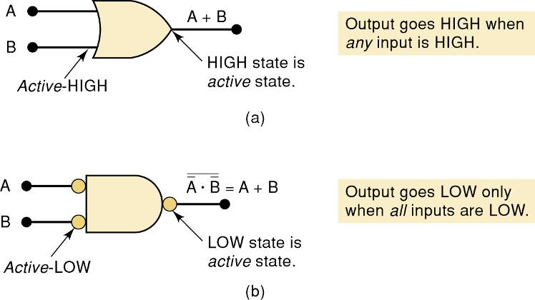
3-13 Alternate Logic-Gate Representations
Interpretation of the two OR gate symbols.

